Slide 1



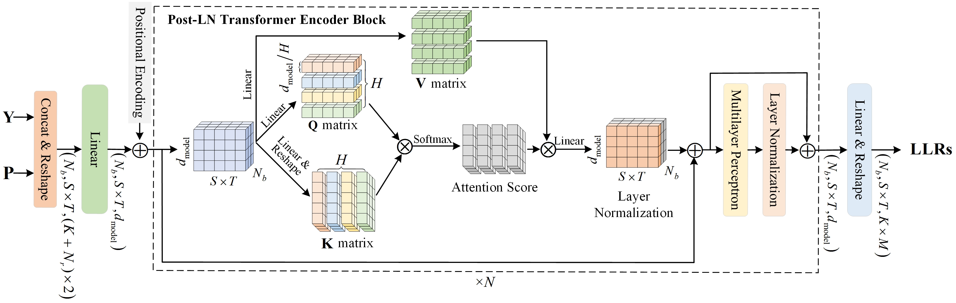
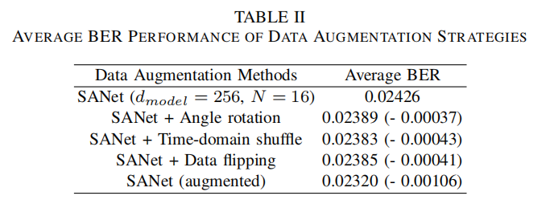
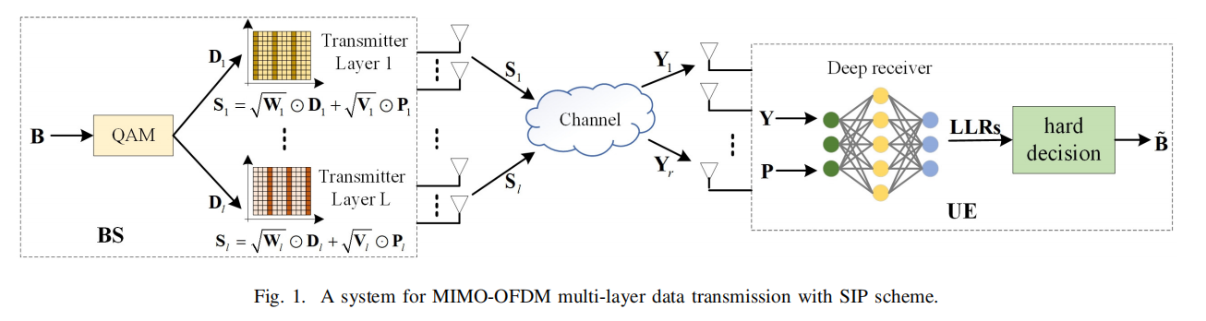

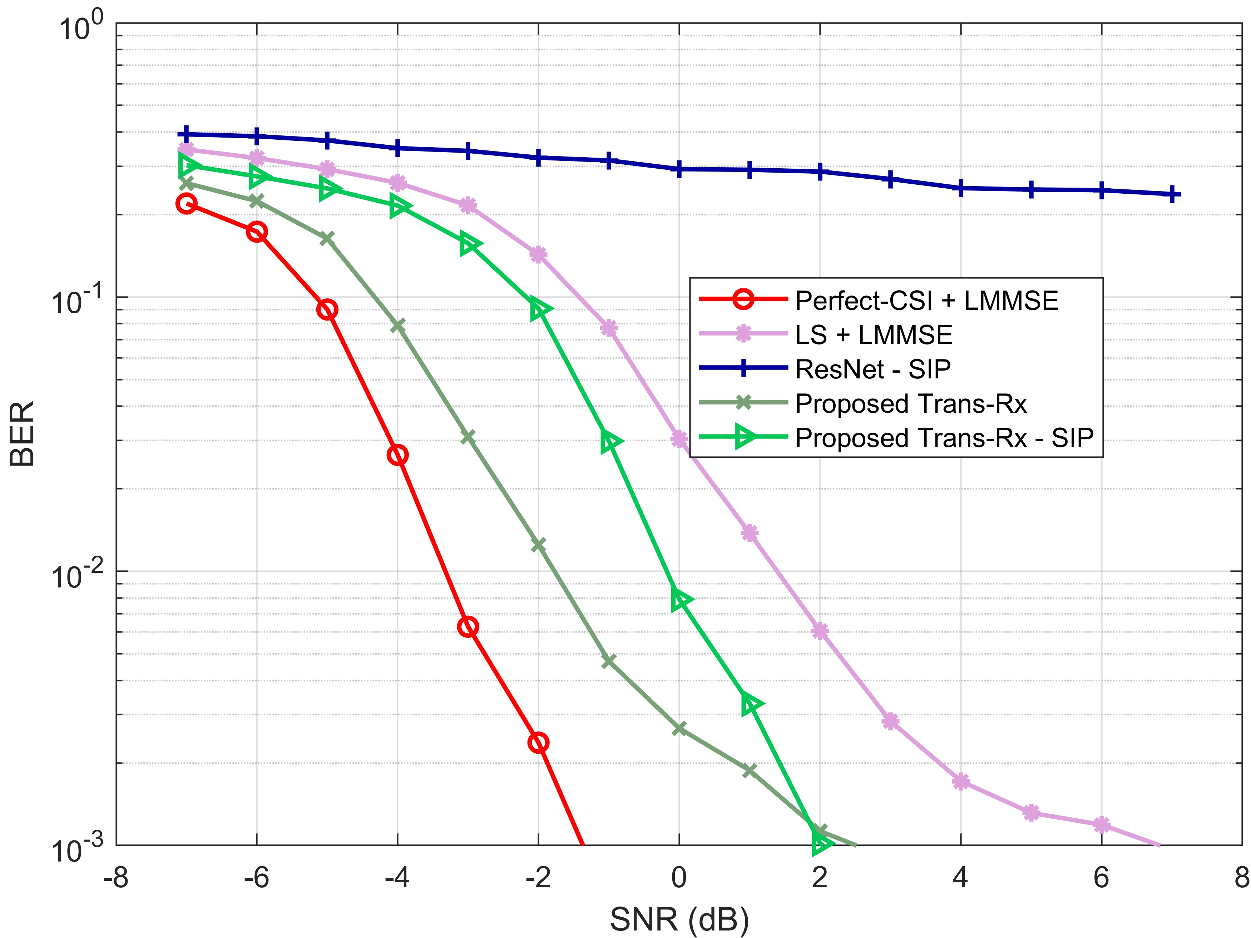
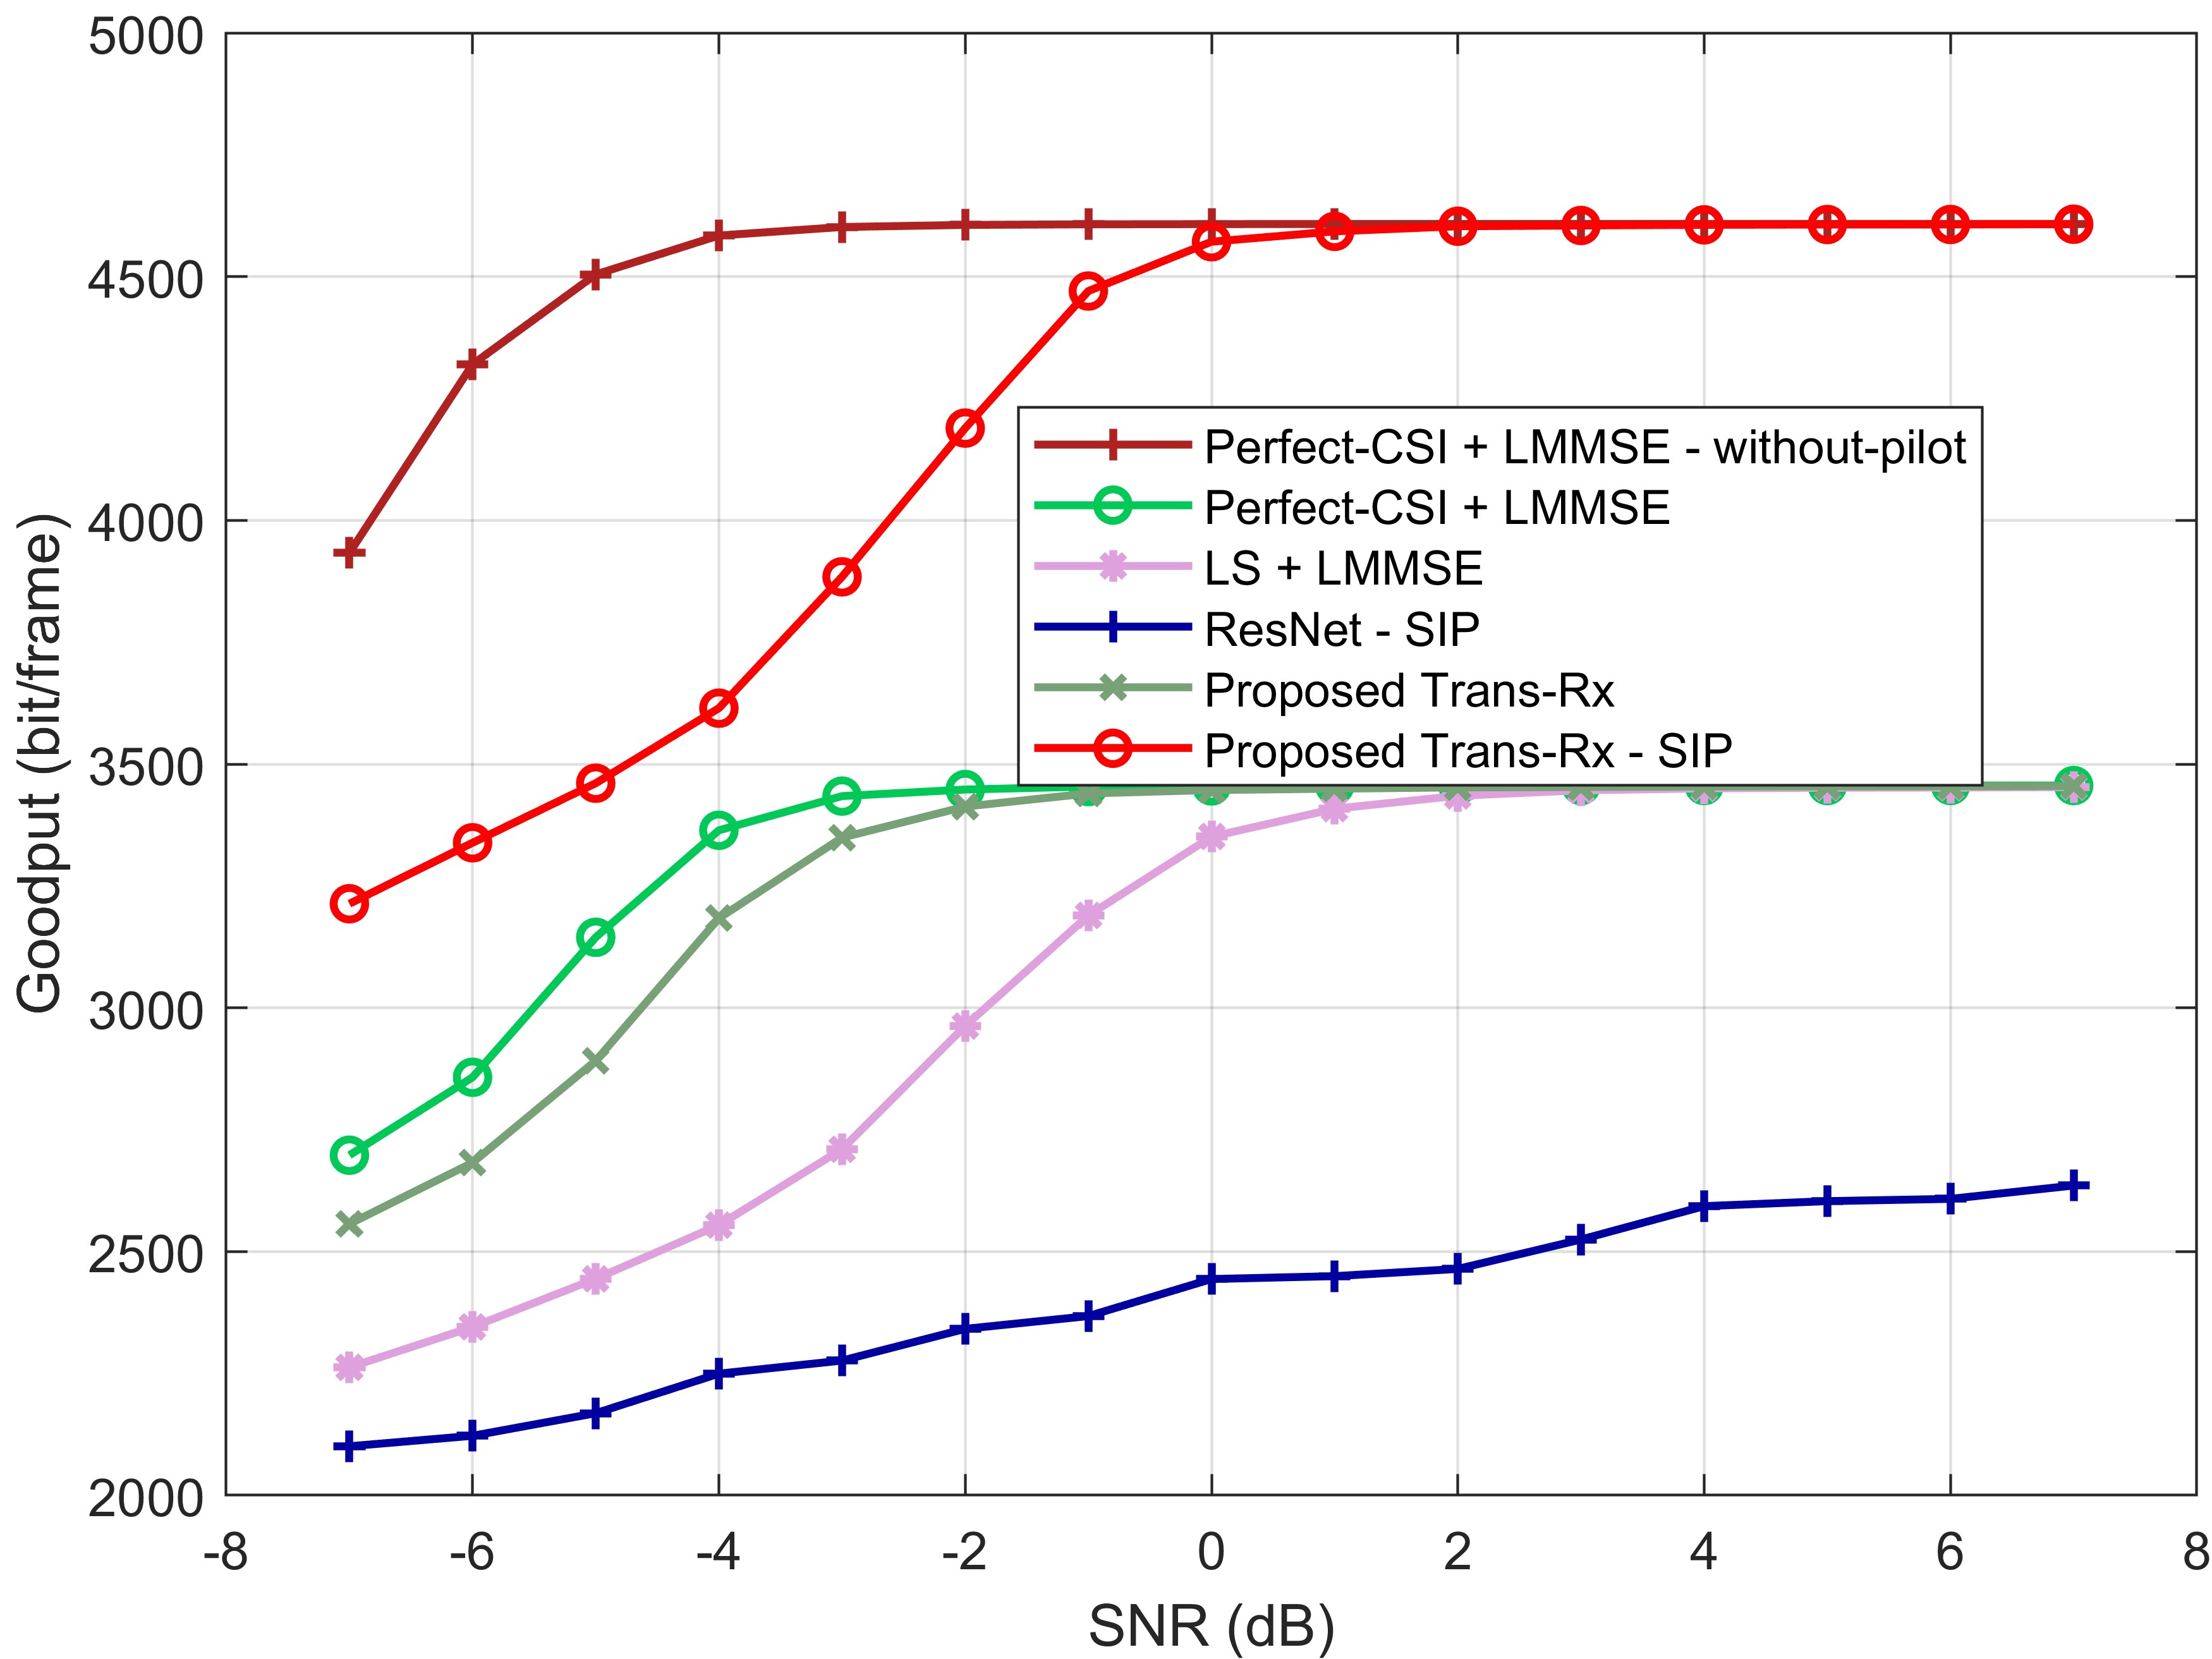
Deep Receiver for Multi-Layer Data Transmission with Superimposed Pilots
Jian Zou^{1, 2} Jian Xiao³ Qingyu Mao¹ Shuai Liu^{1, 2} Bohuai Xiao¹ Yongsheng Liang^{1, 2}*
1.Shenzhen University 2.Shenzhen Technology University 3.Central China Normal University
Motivation
Deep Receiver Based on Multi-Head Self-Attention Mechanism
Data Augmentation Strategy
High Spectrum Efficiency: By superimposing pilots onto data symbols, NOSIP reduces pilot overhead and improves spectral utilization.
Challenges in Multi-Layer Data Transmission: Multi-layer data transmission systems improve throughput by transmitting multiple data streams simultaneously. However, superimposed pilots further complicate the detection process.
End-to-End Learning Capability: Deep receivers leverage data-driven learning to extract complex channel characteristics and mitigate interference from superimposed pilots.
Enhancing Robustness with Data Augmentation: Data augmentation techniques can improve the robustness of both conventional and deep receivers, making them more resilient to real-world uncertainties.
Common Subspace: Extracts shared features from intermediate results in the signal-to-LLR mapping process. By leveraging these shared features across tasks, it improves the receiver's robustness.
Multi-Head Self-Attention: Allows parallel attention to different signal feature layers, enhancing the receiver’s ability to extract key information and improving demodulation accuracy and interference resistance.
This strategy can be dynamically adjusted to meet the specific requirements of various scenarios.
Angle rotation: Different small-angle rotations are applied to all symbols within an OFDM frame.
Time-domain shuffling: The received signal, pilot matrix, and bitstream are shuffled in the time domain according to the same rules.
Data flipping: Symmetric flipping is performed on the user dimension of the pilot matrix and the bitstream matrix.
System Model
Experiments Results
Then, the superimposed symbols are transmitted through the channel and then sent to the UE to obtain the received signal, that is
The goodput upper limit of the SIP scheme is approximately 35.91% higher compared to the
orthogonal pilot scheme. Compared to the “LS + LMMSE” scheme, the proposed SANet scheme based on orthogonal pilots and SIPs has a goodput improvement of approximately 7.01% and 37.15%, respectively.
we developed a data augmentation strategy to further enhance the robustness capability of the receiver.
We consider a MIMO-OFDM downlink system, where transmission resources are allocated across subcarriers in the frequency domain and symbols in the time domain, enabling parallel transmission of an -layer bitstream.
The transmitter performs superposition of pilot and data to obtain superimposed symbols
The superimposed symbols are transmitted through the channel to the UE, resulting in the received signal
That is all！！！
Notes:
Distinguished reviewers, experts, and fellow colleagues, thank you for giving me the opportunity to present our latest research at this conference. I am [Your Name] from [Your Institution], and today I am honored to introduce our work titled ‘Deep Receiver for Multi-Layer Data Transmission with Superimposed Pilots.’ In my presentation, I will cover the research motivation, the system model, our proposed approach, and the experimental results.
Research Motivation:
We begin by examining the context and challenges that inspired this work. Non-Orthogonal Superimposed Pilot Transmission has drawn significant attention for its high spectral efficiency and reduced pilot overhead. However, while this technique offers notable benefits, traditional deep receivers face issues with generalization under diverse channel conditions and real-world scenarios. These limitations in adapting to dynamic channels and ensuring real-time performance motivated us to explore new approaches that can overcome these challenges.
System Model:
Next, I will walk you through the system model we have developed. Our framework integrates multi-layer data transmission with superimposed pilots, forming the backbone of our study. The model captures the interplay between the transmitted multi-layer signals and the non-orthogonal pilot signals, and it effectively addresses the complex interactions between different transmission layers. This comprehensive model serves as the foundation for developing our innovative receiver design.
Proposed Approach:
Our solution involves two key innovations:
Adaptive Deep Receiver Architecture with Meta-Learning:
We leverage meta-learning techniques to enable the deep receiver to quickly adapt to new channel conditions. By training the model across multiple tasks, our approach facilitates rapid adaptation when facing diverse channel environments, significantly enhancing the generalization capabilities of the receiver.
Shift-Rx – A Lightweight Receiver Design:
To tackle the challenge of real-time processing, we propose Shift-Rx, a novel receiver design based on shift operations. This lightweight architecture reduces computational complexity and accelerates signal processing, ensuring that the receiver maintains low latency even in demanding scenarios.
Experimental Results:
Finally, I will present our experimental findings. Using a simulation platform that models various dynamic channel conditions, we compared our proposed approach against conventional deep receivers. The results are very promising: our method not only achieves a lower bit error rate (BER) across multiple channel conditions but also demonstrates significantly improved real-time processing capabilities and system robustness. These outcomes validate our design and underscore the potential for practical applications in complex communication environments.
In conclusion, our work addresses critical challenges in multi-layer data transmission by introducing an adaptive deep receiver enhanced with meta-learning and a lightweight, shift-based architecture. I look forward to discussing these findings further and exploring future directions during the Q&A session. Thank you.”

